Slide 1

PPM 02102025
Pruning Apple Trees for Fruit Production: According to Your Arborist

Slide 2
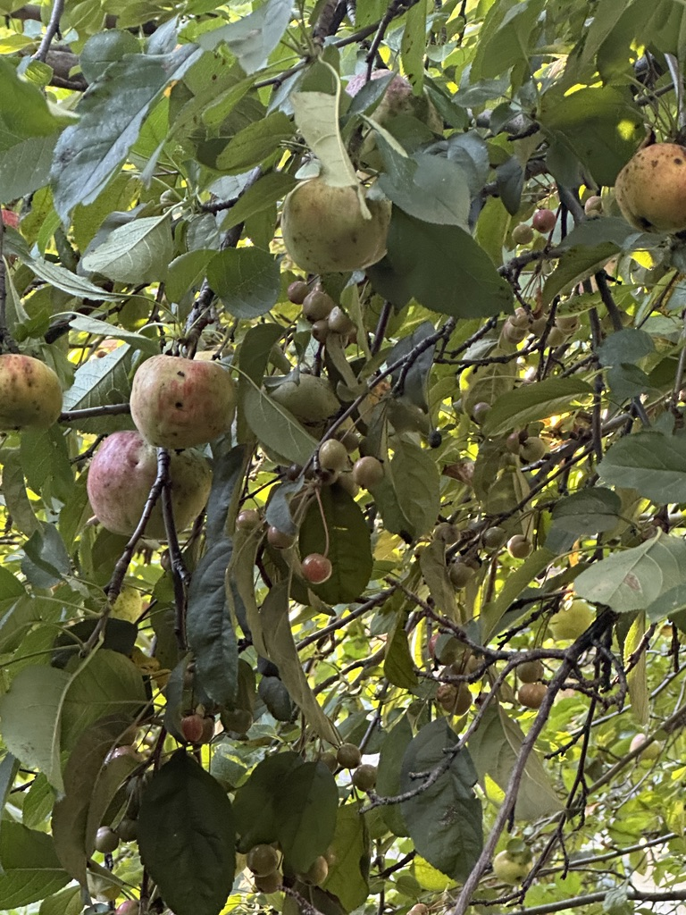
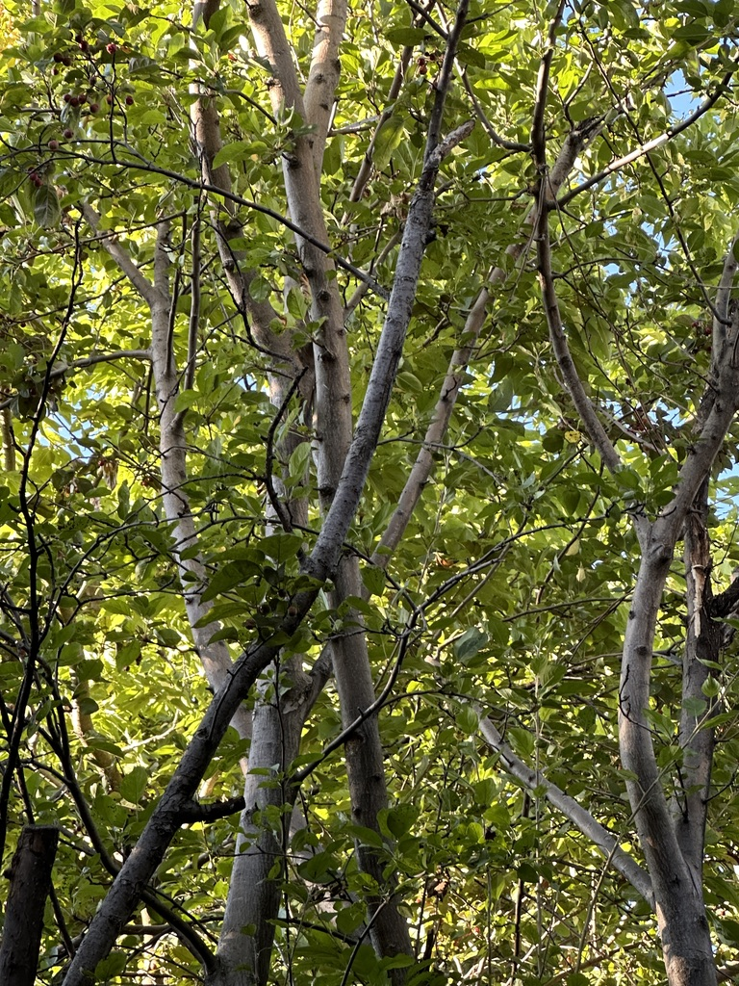
Trees are strange and they do weird shit
While it is important for us to be specialists at tree care: fruit trees, and their care, make up several other careers that each take a lifetime to hone and perfect.
Teaching our customers about the 400 or so years of odd ways that different orchards prefer to prune them is largely not important to us as arborists.
The following is a general set of guidelines for the pruning of apple trees to the extent that we need to be aware of them when working through a residential landscape.
Answering every question that pertains to their perfect commercial care is not relevant is this line of work.

Slide 3
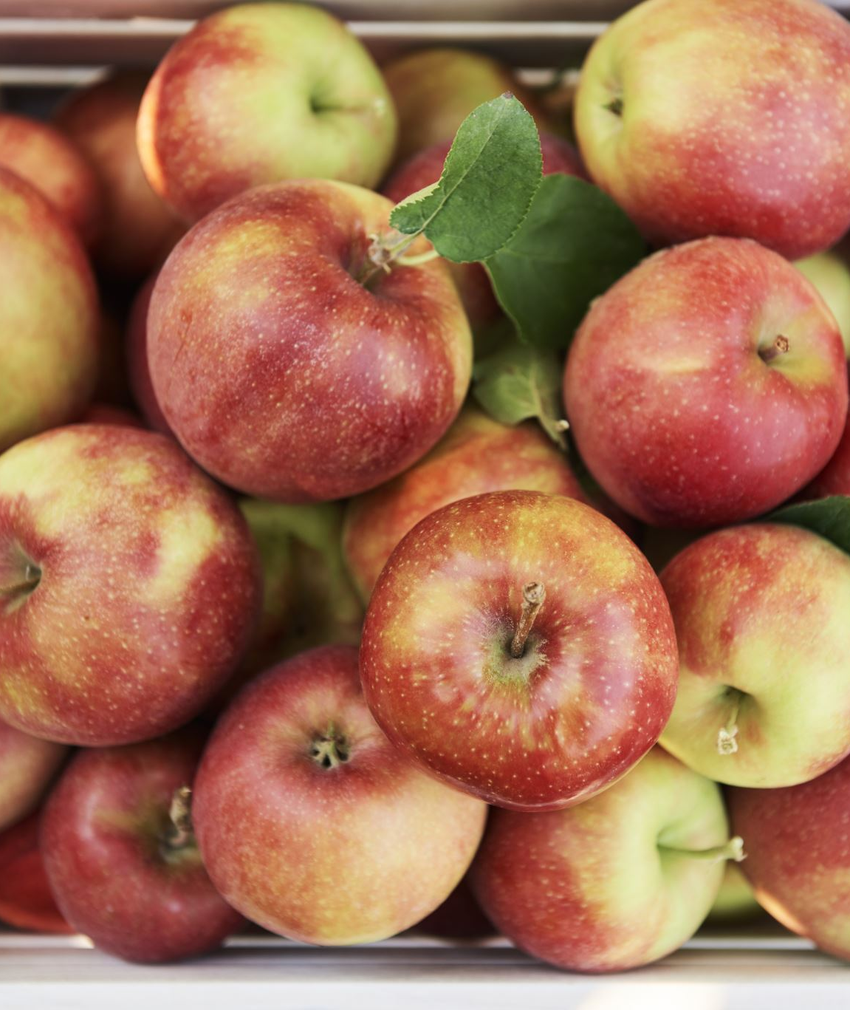
Apple tree origins
Discovered in central Asia and introduced to North America by the French in the 1600’s.
Apples as we know them are the result of thousands of years of human intervention.
Naturally occurring apple trees are likely to produce crabapples.
Apple seeds do not grow true to seed meaning the fruit does not contain seeds that will bear fruit identical to the parent plant.
Apple trees grown commercially are made from cuttings (Clones) of trees that produce the desired apple, and they are grafted onto crabapple root stock.
To produce apples a tree GENERALLY needs to be pollinated by separate tree. There are innumerable exceptions to this, but if someone asks you- this answer will be correct with the highest frequency.

Slide 4
Things to note on apple trees
Sometimes we prune these like any other ornamental, dead wood, clearance, etc.
Tree pruning specifically for fruit production is different than what we’re generally trying to accomplish as arborists.
Utilitarian purposes, while aesthetic is no longer relevant, generally produce a strange looking tree: Pollarding, orchard style fruit tree pruning, clearance from a newly built structure.

Slide 5
Why do we prune apple trees?
Make
Make stouter branches that can hold more fruit
Increase
Increase light penetration through canopy to improve fruit color and quality
Improve
Improve air circulation to reduce fungal problems
Manage
Manage quantity of flower buds to reduce branch breakage in the summer
Maintain
Maintain height and shape to ease harvest
Push
Push fruit to exterior where there is more light and fruit is easier to pick by managing interior growth.

Slide 6
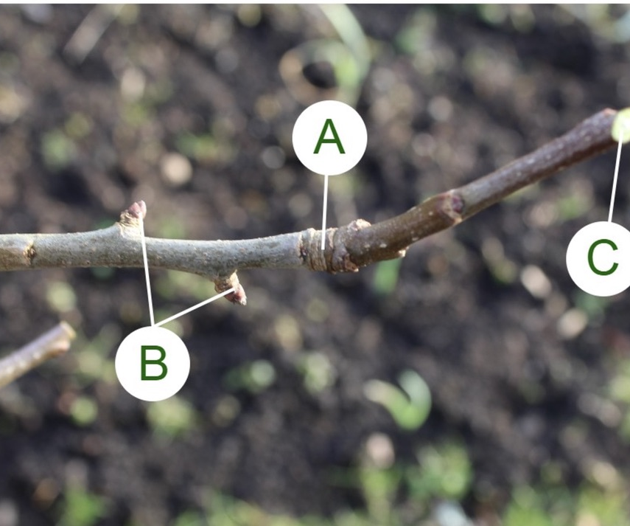
Fruit buds produce apples
New growth this summer from cut made over the winter to reduce the length of the branch. Buds past this line are unlikely to produce fruit.
Last year’s ”spur” buds that are likely to produce fruit. It is important not to accidentally remove during pruning.
Reduction cut.

Slide 7
How to prune an apple tree
-Remove suckers from base of tree
1
-remove large vertical crossing branches
2
-remove dead or dying branches
3
-remove crowded branches
4
-remove water sprouts completely instead of reducing them to avoid more sprouts
5
-establish central leader and reduce all other potential competition.
6
-reduction cuts should target light penetration pushing lateral branch ends into full sun
7
-removing more than 10% - 20% of canopy will produce more suckers requiring more frequent pruning.
8

Slide 8
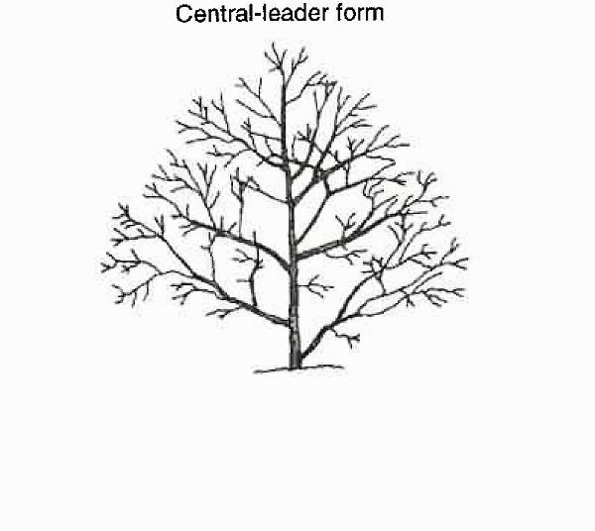
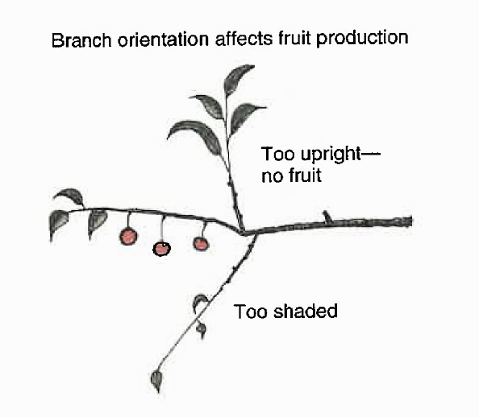
Ideal Tree Structure
Older growth is preserved
Newer growth is shortened
Branches are compact and can physically withstand weight of apples
Branches are all exposed to light
Strong central leader
Very little crowding taking place
Upright growth is largely controlled

